Slide 1


Principles of Programming Languages
(CS F301)
Lexical and Syntax Analysis
Jabez Christopher
Assistant Professor
Department of CSIS

Slide 2
Syntax – Lexemes & Tokens
• Syntax is defined as "the arrangement of words as elements in a sentence to show their relationship."
• Syntax provides a great deal of information that we need to understand a program and to guide its translation.
• Example 2 + 3 x 4 = 14 (not 20 — multiplication takes precedence)
• The lexical structure of program consists of sequence of characters that are assembled into character strings called lexemes which have directly related to tokens, the element of a languages grammar to which they correspond.
• Lexemes fall into several distinct categories:
— reserved words
— literals or constants
— special symbols such as < = +
— identifiers, such as x24 , average , balance

Slide 3
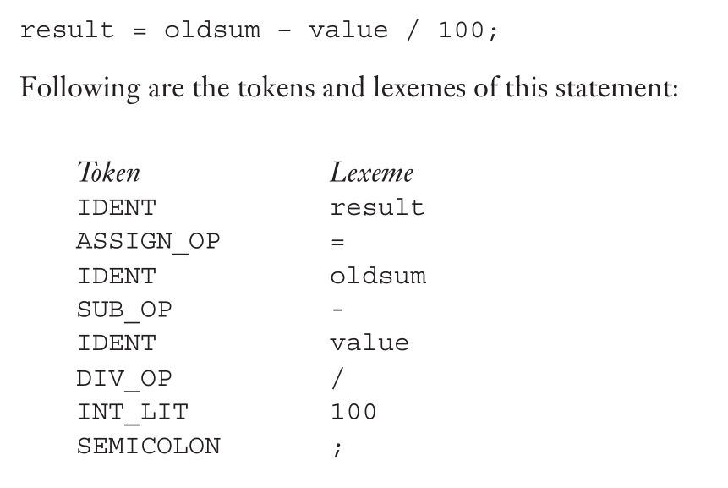
Syntax – Lexemes & Tokens
Lexical analyzers extract lexemes from a given input string and produce the
corresponding tokens.

Slide 4
SYNTAX Analysis
The syntax analysis portion of a language has two parts:
1. A low-level part called a lexical analyzer (mathematically, a finite automaton based on a regular grammar)
2. A high-level part called a syntax analyzer, or parser (mathematically, a push-down automaton based on a context-free grammar, or BNF)
LEXICAL-ANALYSIS PROCESS
Skips comments and white space
Inserts lexemes for user-defined names into the symbol table
Detect syntactic errors in tokens
Report such errors to the user

Slide 5
Building a lexical analyzer
APPROACHES TO BUILD A LEXICAL ANALYZER
Write a formal description of the token patterns of the language usinga descriptive language. Eg. Reg. Expr; these descriptions are given as inputs to s/w tools to generate analyzers.
Design a state transition diagram that describes the token patterns of the language and write a program that implements the diagram.
Hand-construct a table-driven implementation of the state diagram

Slide 6
Building a lexical analyzer
State diagram, is a directed graph. The nodes of a state diagram are labeled with state names.
State diagrams are representations of finite automata.
The tokens of a programming language are a regular language, and a lexical
analyzer is a finite automaton.

Slide 7
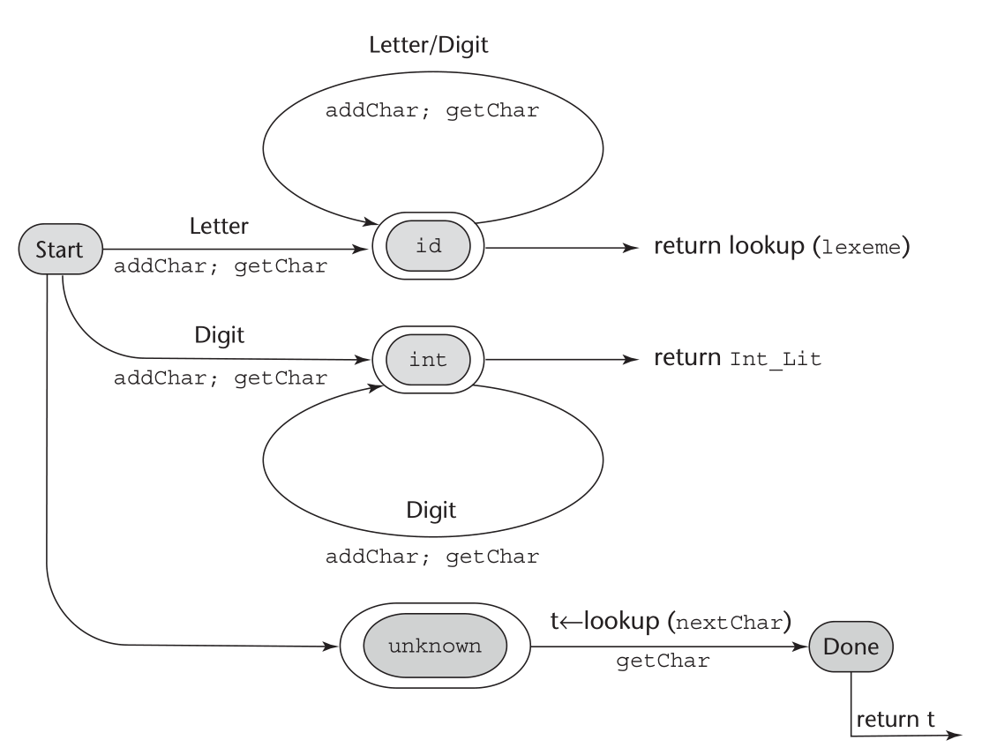
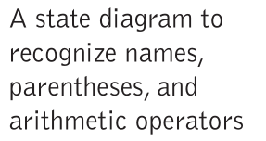

Slide 8
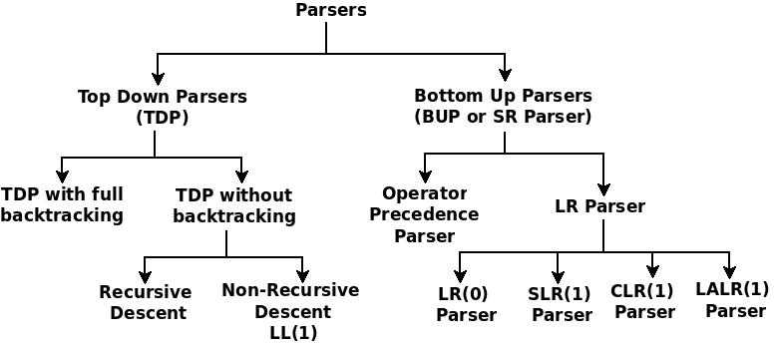
PARSING
Syntax analysis is often called parsing.

Slide 9
TDP vs BUP
Top-down parser:
starts at the root of derivation tree and fills in
picks a production and tries to match the input
may require backtracking
some grammars are backtrack-free (predictive)
makes a decision inorder to use the right production for deriving the string
Bottom-up parser:
starts at the leaves and fills in
starts in a state valid for legal first tokens
as input is consumed, changes state to encode possibilities (recognize valid prefixes)
uses a stack to store both state and sentential forms
makes a decision whether to shift or reduce.

Slide 10
TOP-DOWN PARSER
A top-down parser starts with the root of the parse tree, labeled with the start or goal symbol of the grammar.
To build a parse, it repeats the following steps until the fringe of the parse tree matches the input string
At a node labeled A, select a production A → α and construct the appropriate child for each symbol of α
When a terminal is added to the fringe that doesn´t match the input string, backtrack
Find the next node to be expanded (must have a label in V_{n})
The key is selecting the right production in step 1
⇒ should be guided by input string

Slide 11
Backtracking - Example
Grammar
Input string x y z
Sentential form
S
# | Production rule
1 2 | S -> x P z P -> yw | y
x
P
z
First input string matches
with the leftmost node, hence
Advance the input string pointer

Slide 12
Backtracking - Example
Grammar
Input string x y z
Sentential form
S
# | Production rule
1 2 | S -> x P z P -> yw | y
x
P
z
Match next node P with current
Character in input string. It does
not match and P is non terminal
Hence expand.

Slide 13
Backtracking - Example
Grammar
Input string x y z
Sentential form
S
# | Production rule
1 2 | S -> x P z P -> yw | y
x
P
z
y
w
Match, hence advance
The input string pointer

Slide 14
Backtracking - Example
Grammar
Input string x y z
Sentential form
S
# | Production rule
1 2 | S -> x P z P -> yw | y
x
P
z
y
w
Mismatch
Hence backtrack
And use other
Production of P

Slide 15
Backtracking - Example
Grammar
Input string x y z
Sentential form
S
# | Production rule
1 2 | S -> x P z P -> yw | y
x
P
z
y

Slide 16
Backtracking - Example
Grammar
Input string x y z
Sentential form
S
# | Production rule
1 2 | S -> x P z P -> yw | y
x
P
z
y
Matching done for
entire string

Slide 17
Recursive descent parsing
Write a parse method for each nonterminal in the grammar
Each parse method should get the tokens it needs, and only those tokens
Those tokens (usually) go on the stack
Each parse method may call other parse methods, and expect those methods to leave their results on the stack
Each (successful) parse method should leave one result on the stack

Slide 18
Recursive descent parsing
Example: while statement
<while statement> ::= “while” <condition> <block>
The parse method for a while statement:
Calls the Tokenizer, which returns a “while” token
Makes the “while” into a tree node, which it puts on the stack
Calls the parser for <condition>, which parses a condition and puts it on the stack
Stack now contains: “while” <condition> (“top” is on right)
Calls the parser for <block>, which parses a block and puts it on the stack
Stack now contains: “while” <condition> <block>
Pops the top three things from the stack, assembles them into a tree, and pushes this tree onto the stack

Slide 19
Recursive descent parsing
Recognizing a while statement
// <while statement> ::= “while” <condition> <block> private boolean whileStatement() { if (keyword("while")) { if (condition()) { if (block()) { return true; } else error("Missing '{' "); } else error("Missing <condition>"); } return false; }

Slide 20
Recursive descent parsing
Simple makeTree() method
After recognizing a while loop, the stack looks like this:
<block>
<condition>
Code can be like this:
private void makeTree() { Tree right = stack.pop(); Tree left = stack.pop(); Tree root = stack.pop(); root.addChild(left); root.addChild(right); stack.push(root); }
while
while
<condition>
<block>
This code assumes that the root is the third item down, etc., and that isn’t always the case
It is more convenient to write more flexible methods

Slide 21
LEFT-RECURSION
Top-down parsers cannot handle left-recursion in a grammar
Formally, a grammar is left-recursive if
∃A ∈ V_{n} such that A ⇒⁺ Aα for some string α
<expr> ::= <expr> + <term>
| <expr> - <term>
| <term>
<term> ::= <term> * <factor>
| <term> / <factor>
| <factor>
<expr> ::= <term> <expr´>
<expr´> ::= + <term> <expr´>
| - <term> <expr´>
| ε
<term> ::= <factor> <term´>
<term´> ::= * <term´>
| / <term´>
| ε

Slide 22
LOOK-AHEAD
We saw that top-down parsers may need to backtrack when they select the wrong production
Do we need arbitrary look-ahead to parse CFGs?
in general, yes
use the Earley or Cocke-Younger, Kasami algorithms
Aho, Hopcroft, and Ullman, Problem 2.34 Parsing, Translation and Compiling, Chapter 4
Fortunately
large subclasses of CFGs can be parsed with limited lookahead
most programming language constructs can be expressed in a grammar that falls in these subclasses
Among the interesting subclasses are:
LL(1): left to right scan, left-most derivation, 1-token look-ahead; and
LR(1): left to right scan, right-most derivation, 1-token look-ahead

Slide 23
Predictive parsing
Basic idea:
For any two productions A → α | β, we would like a distinct way of choosing the correct production to expand.
For some RHS α ∈ G, define FIRST(α) as the set of tokens that appear first in some string derived from α
I.e., for some w ∈ V_{t}*, w ∈ FIRST(α) iff α ⇒*wγ
Key property:
Whenever two productions A → α and A → β both appear in the grammar, we would like:
FIRST(α) ∩ FIRST(β) = ∅
This would allow the parser to make a correct choice with a look-ahead of only one symbol!

Slide 24
LEFT FACTORING
we can transform a grammar to have this property:
For each non-terminal A find the longest prefix α common to two or more of its alternatives.
if α ≠ ε then replace all of the A productions A → αβ₁ | αβ₂ | … | αβ_{n} with A → α A´
A´ → β₁ | β₂ | … | β_{n} where A´ is fresh
Repeat until no two alternatives for a single non-terminal have a common prefix.

Slide 25
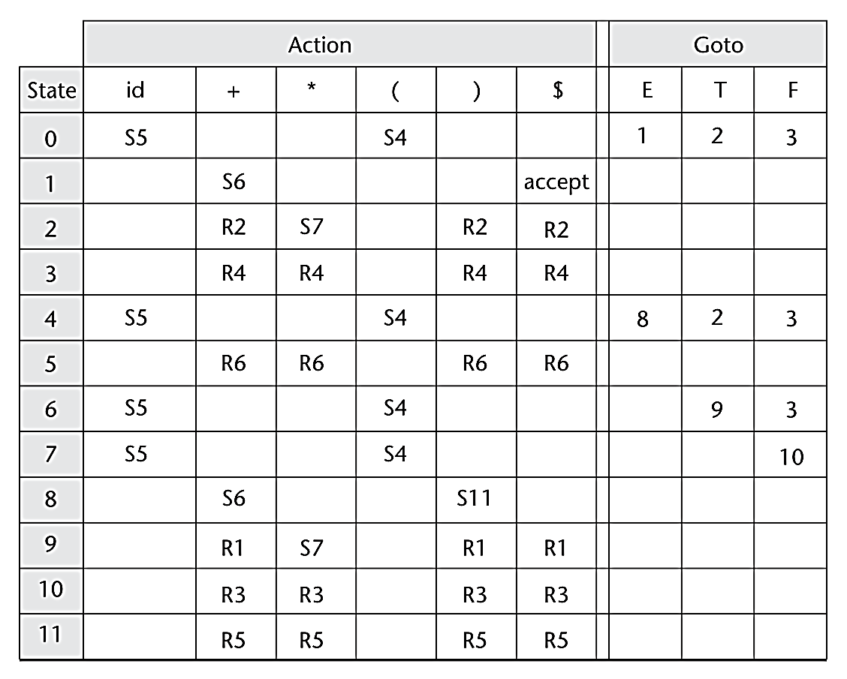
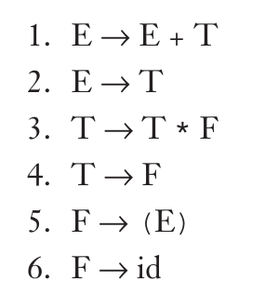

Slide 26
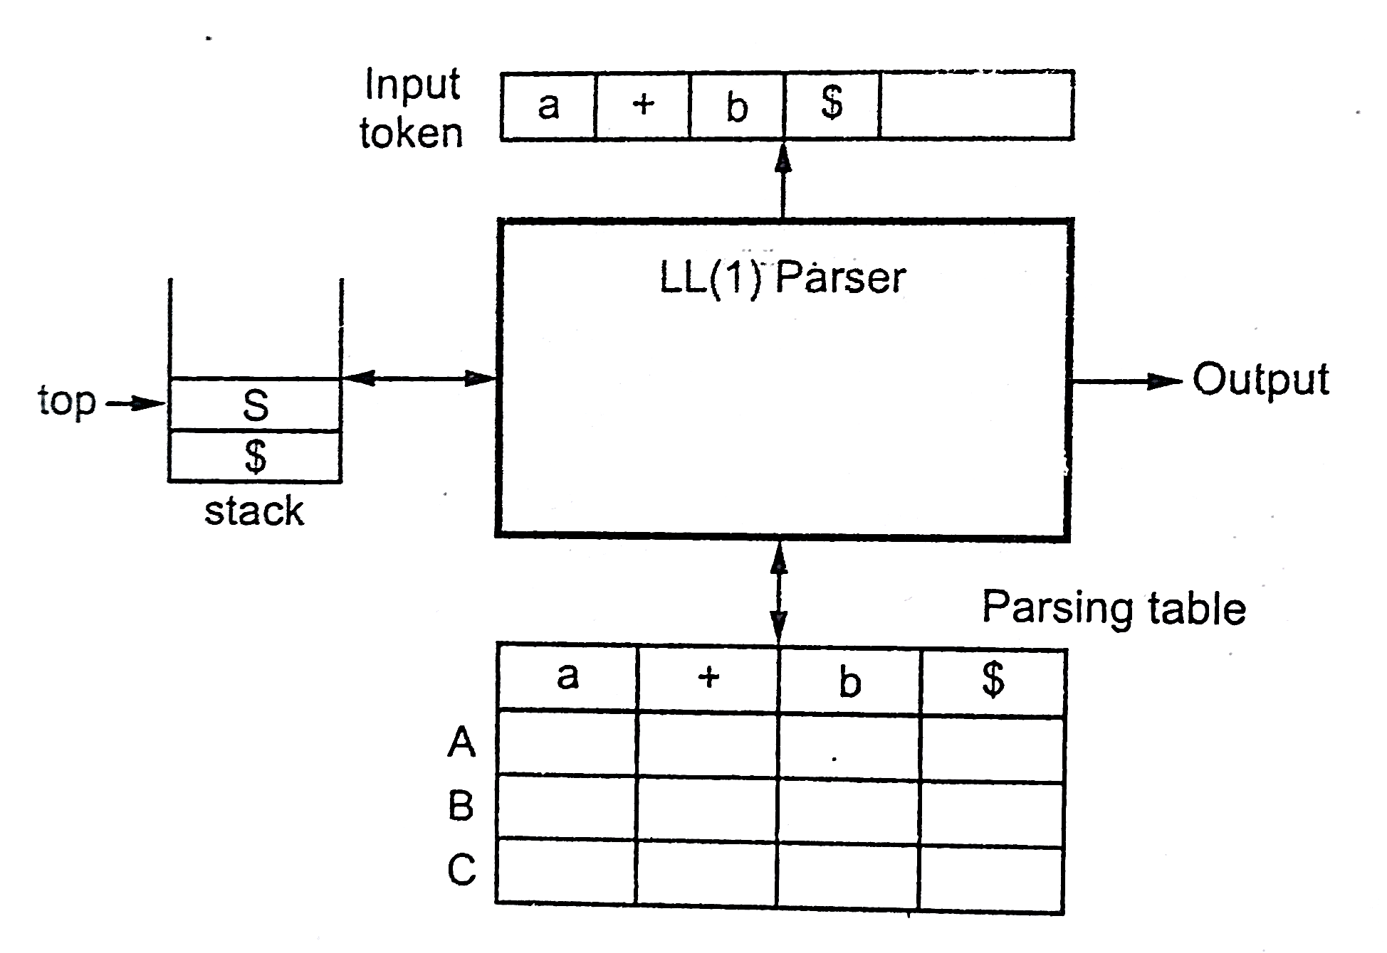
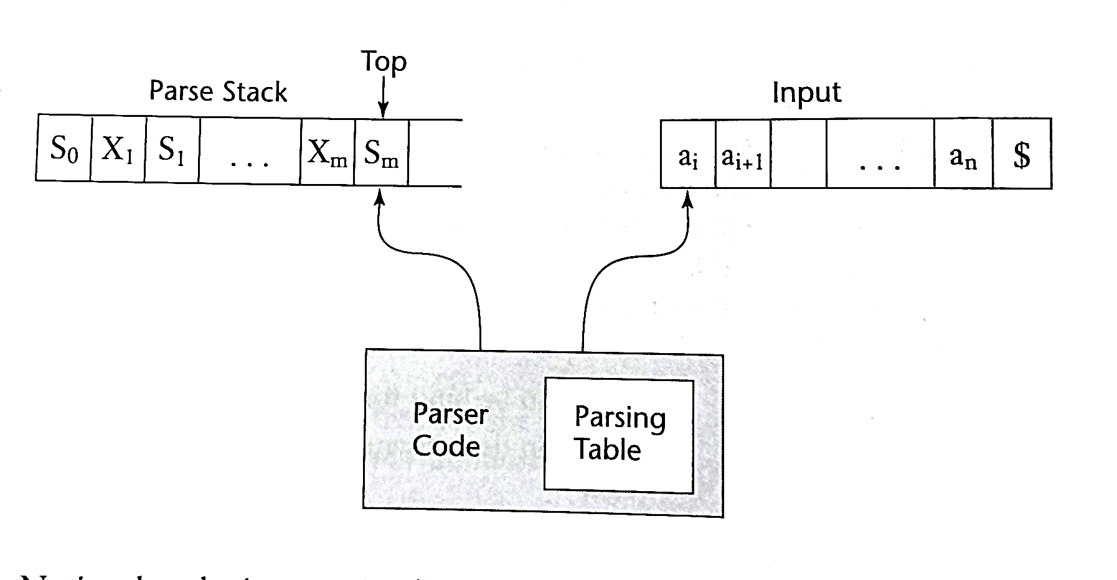
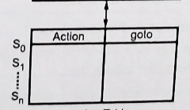
PUSH DOWN AUTOMATA

Slide 27
FIRST
For a string of grammar symbols α, define FIRST(α) as:
the set of terminal symbols that begin strings derived from α: { a ∈ V_{t} | α ⇒* aβ }
If α ⇒* ε then ε ∈ FIRST(α)
FIRST(α) contains the set of tokens valid in the initial position in α.
To build FIRST(X):
If X ∈ V_{t}, then FIRST(X) is { X }
If X → ε then add ε to FIRST(X)
If X → Y₁ Y₂ … Y_{k}
Put FIRST(Y₁) — {ε} in FIRST(X)
∀i: 1 < i ≤ k, if ε ∈ FIRST(Y₁) ∩ … ∩ FIRST(Y_{i-1}) (i.e., Y₁ Y₂ … Y_{i-1} ⇒* ε) then put FIRST(Y_{i}) — {ε} in FIRST(X)
If ε ∈ FIRST(Y₁) ∩ … ∩ FIRST(Y_{k}) then put ε in FIRST(X)
Repeat until no more additions can be made.

Slide 28
FOLLOW
For a non-terminal A, define FOLLOW(A) as:
the set of terminals that can appear immediately to the right of A in some sentential form
I.e., a non-terminal’s FOLLOW set specifies the tokens that can legally appear after it.
A terminal symbol has no FOLLOW set.
To build FOLLOW(A):
Put $ in FOLLOW(<goal>)
If A → αBβ:
Put FIRST(β) – {ε} in FOLLOW(B)
If β = ε (i.e., A → αB) or ε ∈ FIRST(β) (i.e., β ⇒* ε) then put FOLLOW(A) in FOLLOW(B)
Repeat until no more additions can be made

